Slide 1



Future of AI
30/10/2025
AI in education & society, ethics, fairness and responsible AI

Slide 2

What is AI in Education?
Data
AI analysis
Feedback
Learning Improvement
In education, AI is used to personalize learning experiences, provide feedback, support teachers with administrative tasks, and enhance accessibility for diverse learners.
October 2025 |

Slide 3
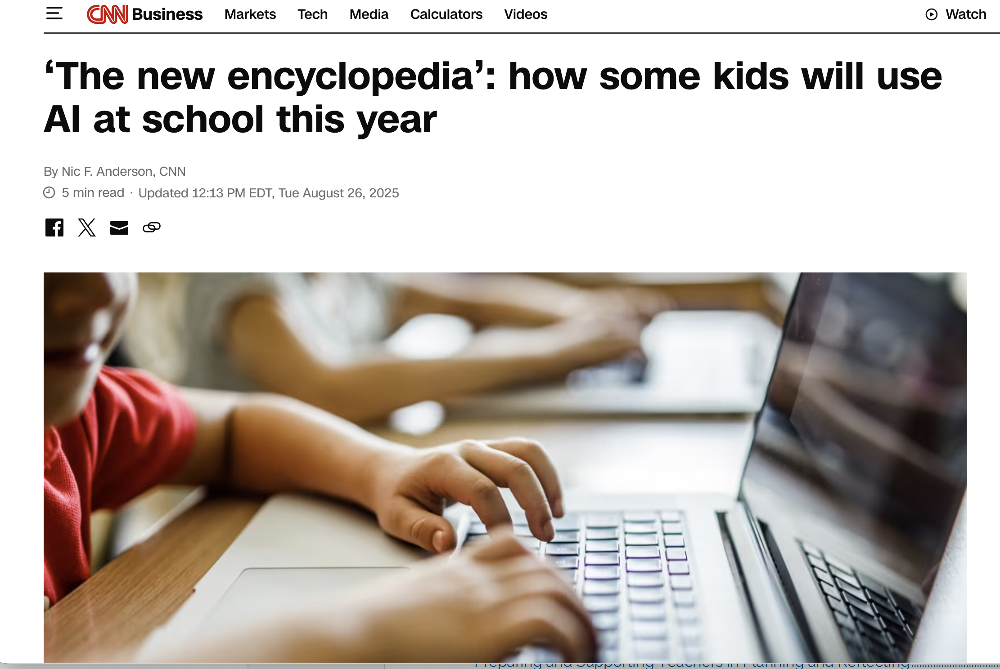
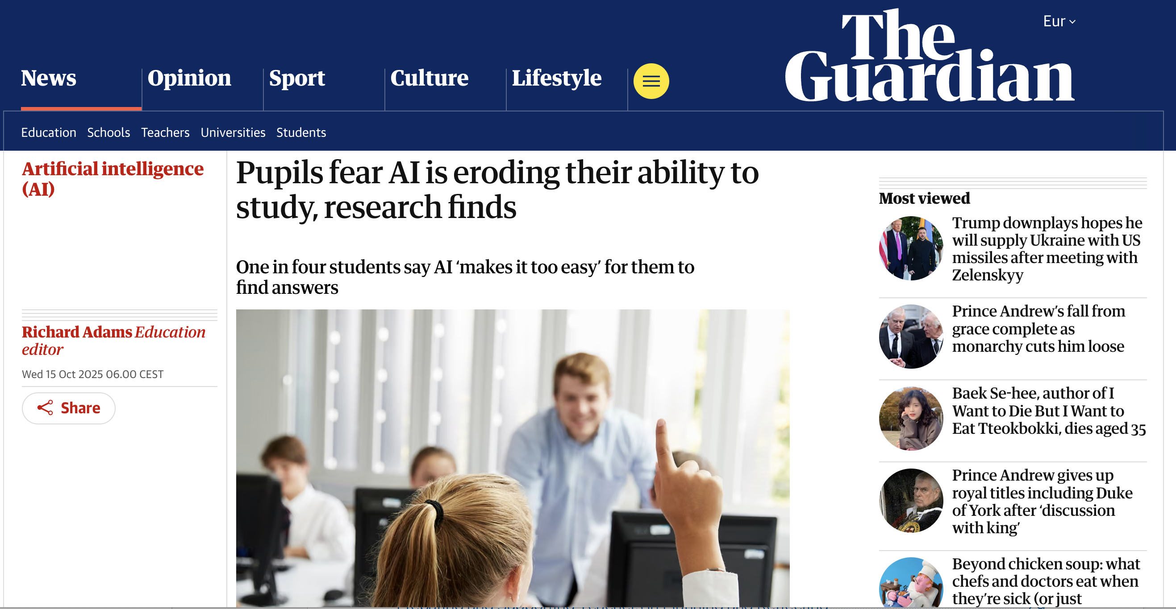
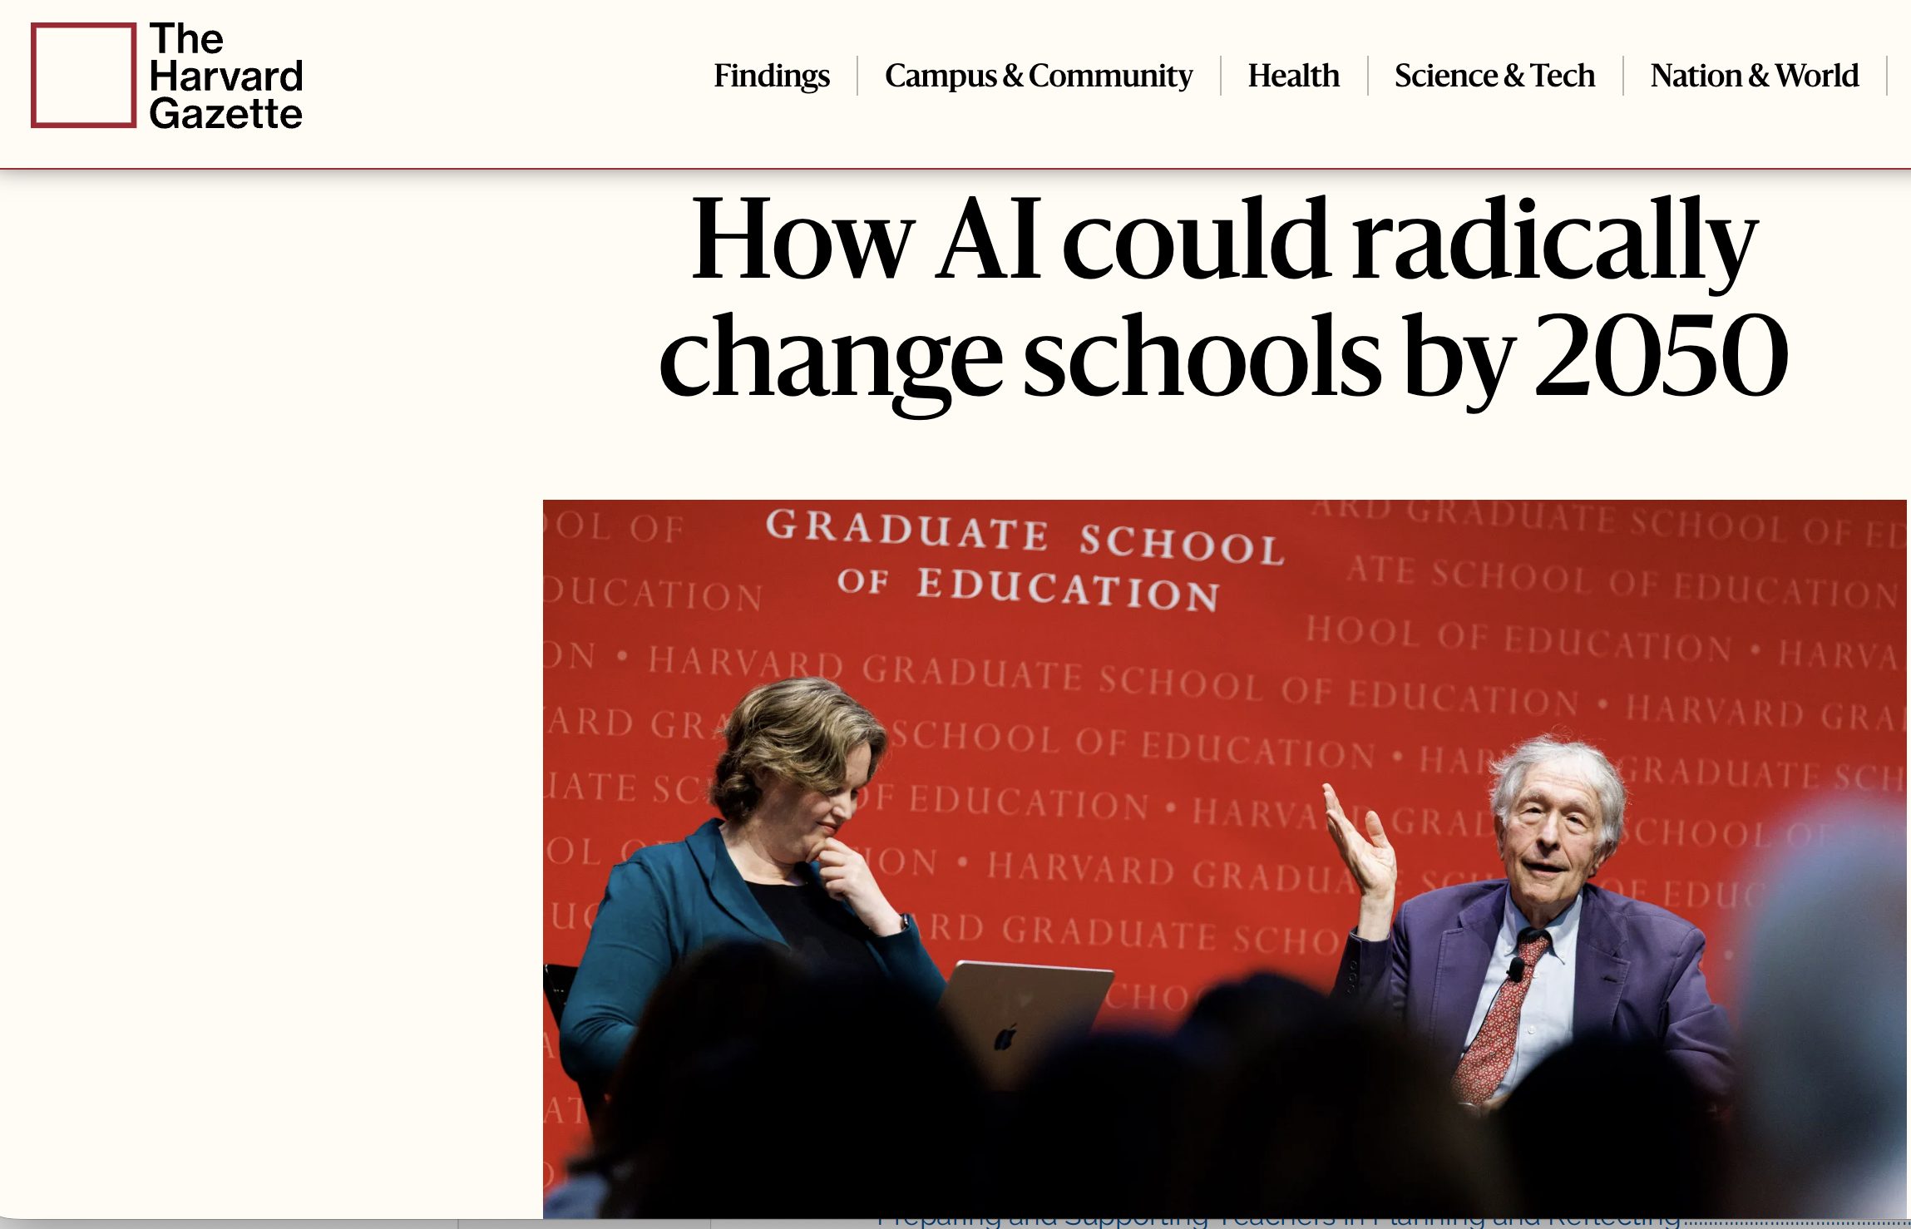
Why Discuss AI in Education Now?
The rapid spread of AI tools like ChatGPT, Copilot and adaptive learning platforms is transforming how students learn and how teachers design lessons.
At the same time, schools are facing questions about privacy, accuracy, bias and how to maintain human-centered education in the AI era.
October 2025 |

Slide 4
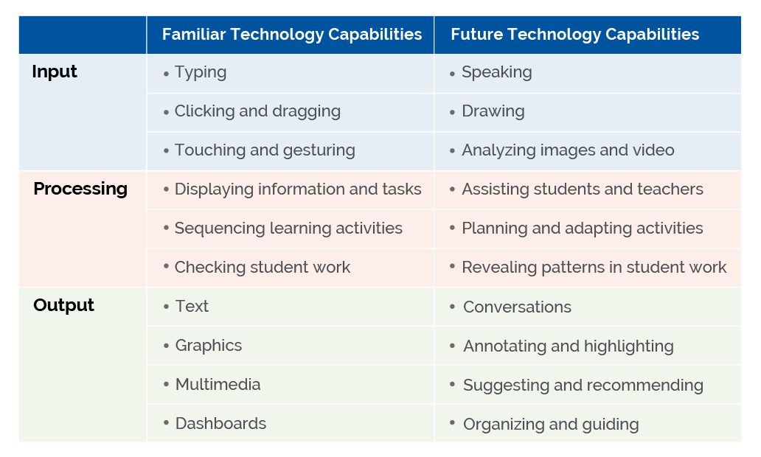
AI Systems Enable New Forms of Interaction
AI models allow computational processes to make recommendations or plans and also enable them to support forms of interaction that are more natural, such as speaking to an assistant.
AI-enabled educational systems will be desirable in part due to their ability to support more natural interactions during teaching and learning.
October 2025 |

Slide 5
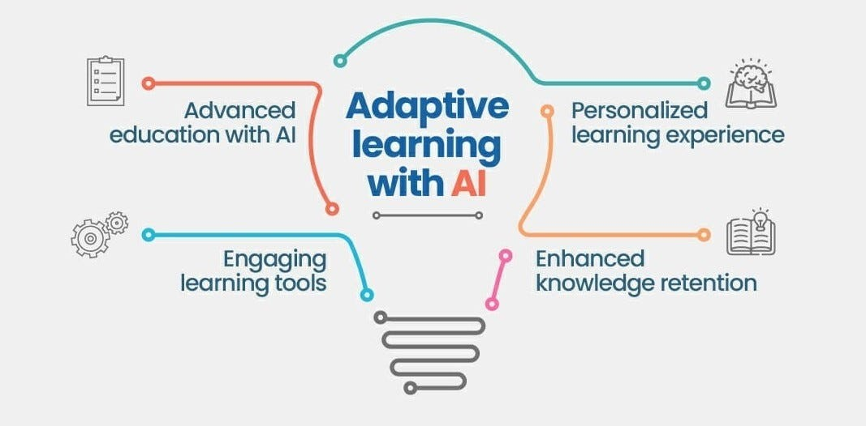
AI Enables Adaptivity in Learning
Adaptivity has been recognized as a key way in which technology can improve learning.25 AI can be a toolset for improving the adaptivity of Edtech.
AI may improve a technology’s ability to meet students where they are, build on their strengths, and grow their knowledge and skills.
And yet, especially with AI, when important parts of human learning are left out of the model or less fully developed, the resulting adaptivity will also be limited, and the resulting supports for learning may be brittle or narrow.
October 2025 |

Slide 6
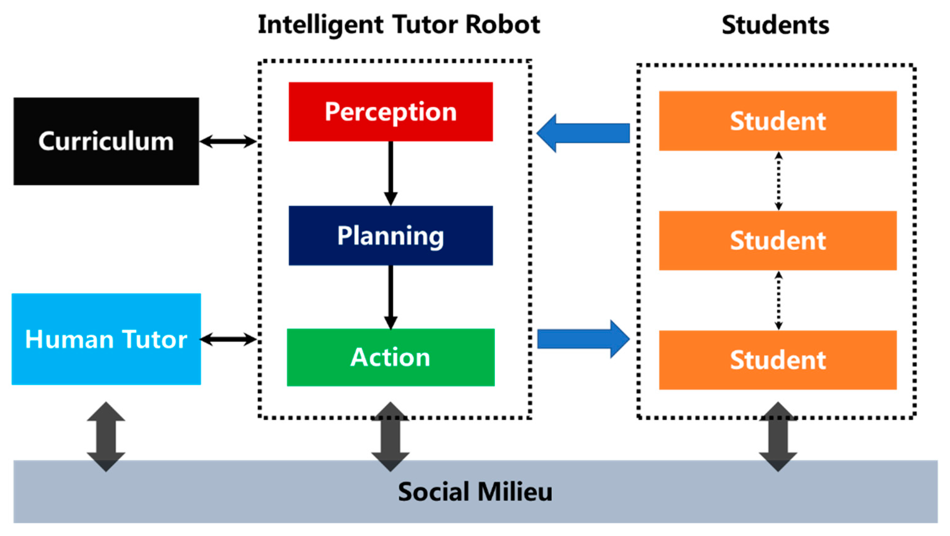
An example: Intelligent Tutoring Systems
The Intelligent Tutoring System would observe student problem solving as they work on several tasks and guide them towards a solution.
By Integrating Teachers in the Loop, ITS might focus on problem solving practice, while teachers work with students in small groups.
October 2025 |

Slide 7
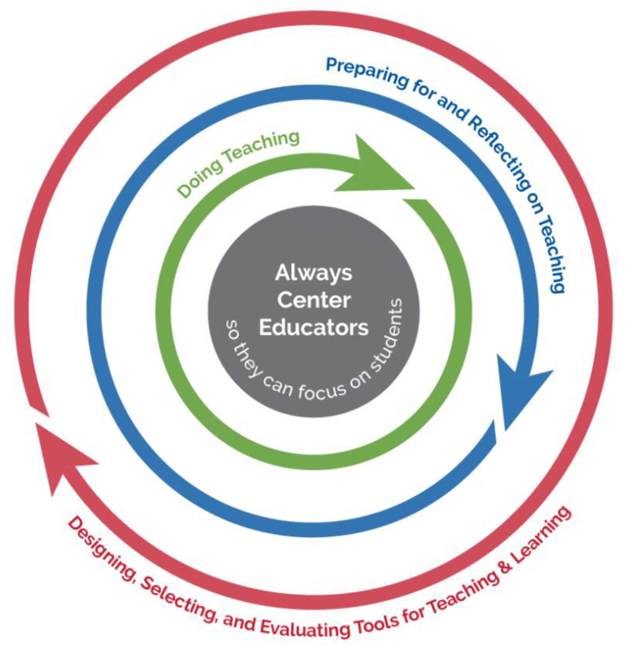
Centering Educators in Instructional Loops
To succeed with AI as an enhancement to learning and teaching, we need to always center educators (ACE).
October 2025 |

Slide 8
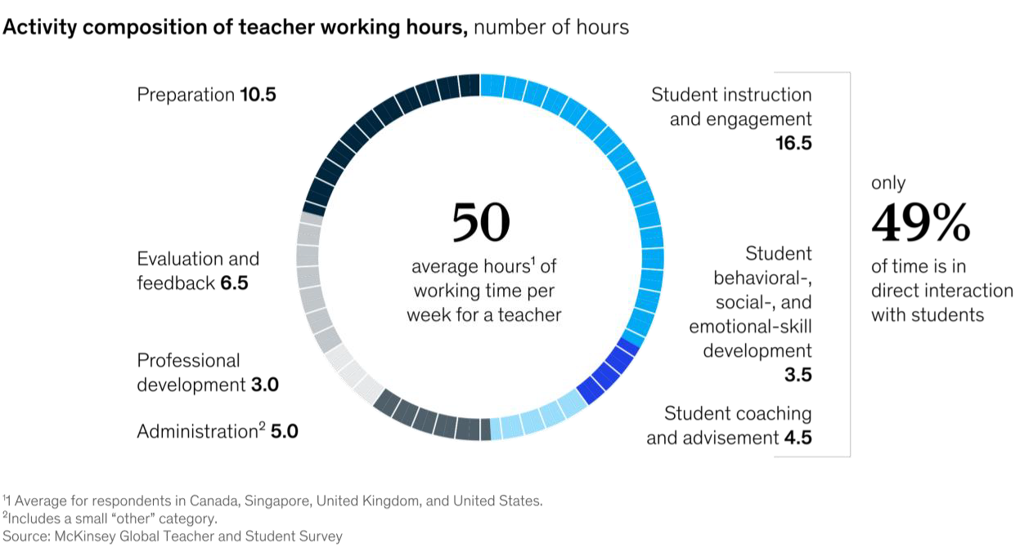
Composition of Teachers Working Hours
October 2025 |

Slide 9
Using AI to Improve Teaching Jobs
Handling low-level details to ease teaching burdens and increase focus on students.
Extending beyond the teacher's availability with their students but continuing to deliver on the teacher’s intent.
Making teacher professional development more productive and fruitful.
October 2025 |

Slide 10
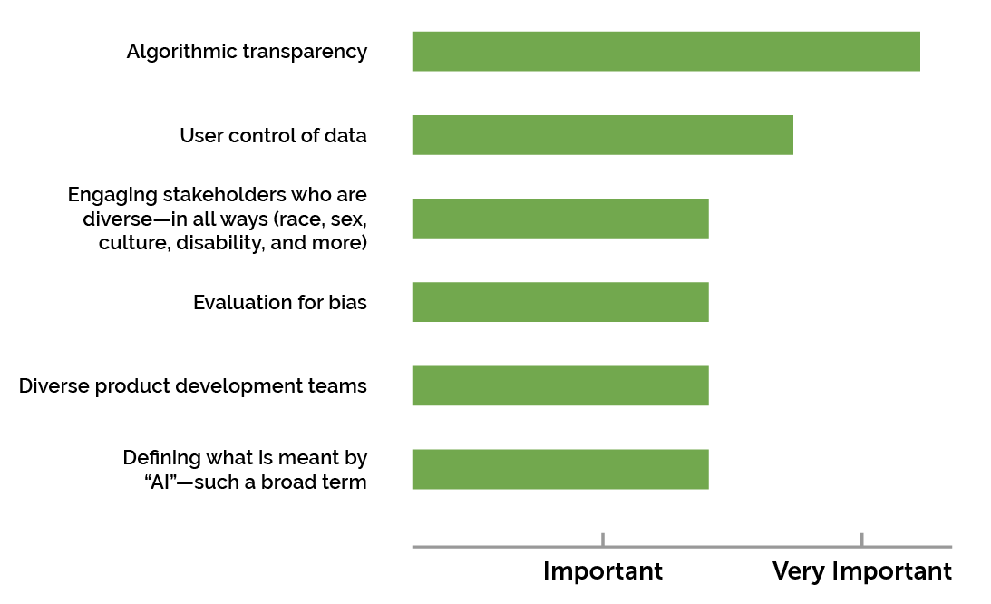
Concerns about Teaching with AI
October 2025 |

Slide 11
Recommendations on Implementation
Emphasize humans in the loop
Align AI models to a shared vision for education
Design using modern learning principles
Prioritize strengthening trust
Inform and involve educators
Focus R&D on addressing context and enhancing trust and safety
Develop education-specific guidelines and guardrails
October 2025 |

Slide 12
Some Examples
Academic Research | Startups
SocraticLM | Khanmigo
LeanLM | Coursera – Coach
ASSISTments | Knewton Alta
MathFlowLens | Kira Learning
October 2025 |

Slide 13
How to use AI safely and fairly?
October 2025 |

Slide 14
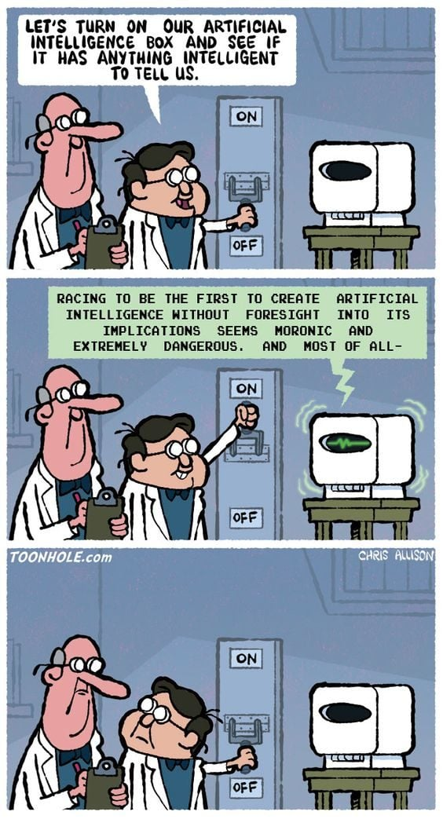
Understanding Risks
Risk refers to the composite measure of an event’s probability of occurring and the magnitude or degree of the consequences of the corresponding event.
The impacts, or consequences, of AI systems can be positive, negative, or both and can result in opportunities or threats.
AI risk management efforts should consider that humans may assume that AI systems work – and work well – in all settings.
October 2025 |

Slide 15
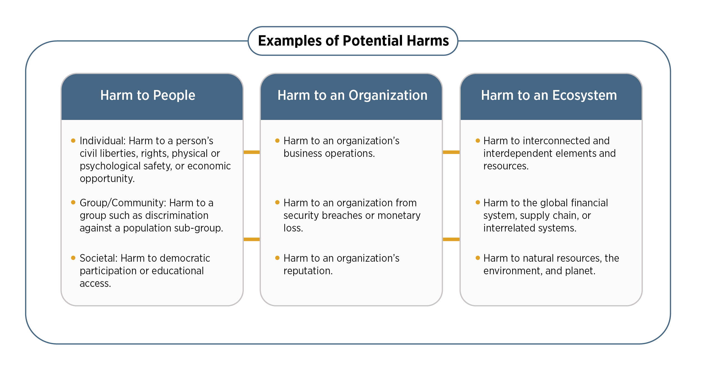
Potential Harms Related to AI Systems
October 2025 |

Slide 16


Biases in AI
Models trained on the Internet have biases at the scale of the Internet.
https://www.vox.com/future-perfect/23023538/ai-dalle-2-openai-bias-gpt-3-incentives
https://algorithmwatch.org/en/google-vision-racism/
October 2025 |

Slide 17
Sources of bias
Algorithm bias - if the problem or question asked is not fully correct or specific
Cognitive bias - Personal bias can seep in without practitioners even realizing it
Confirmation bias - happens when AI relies too much on pre-existing beliefs or trends in the data
Exclusion bias - occurs when important data is left out of the data being used
Measurement bias - caused by incomplete data
Out-group homogeneity bias - a case of not knowing what one doesn’t know
Prejudice bias - Occurs when stereotypes and faulty societal assumptions find their way into the algorithm’s dataset
Recall bias - develops during data labeling
Sample/Selection bias - a problem when the data used to train the machine learning model isn't large enough
Stereotyping bias - when an AI system—usually inadvertently—reinforces harmful stereotypes
October 2025 |

Slide 18
Challenges for AI Risk Management
Risk Measurement - AI risks or failures that are not well-defined or adequately understood are difficult to measure quantitatively or qualitatively.
Risk Tolerance - can be influenced by legal or regulatory requirements. Risk tolerance and the level of risk that is acceptable to organizations or society are highly contextual and application and use-case specific.
Risk Prioritization - Risk prioritization may differ between AI systems that are designed or deployed to directly interact with humans as compared to AI systems that are not.
Integration & Management of Risk - Different AI actors have different responsibilities and awareness depending on their roles in the lifecycle.
October 2025 |

Slide 19


AI Slop?
“AI slop” refers to large-volumes of low-quality AI-generated content (text, images, video) created with little human oversight, minimal substance, and often for mere engagement or profit.
It tends to prioritize speed and quantity over meaning, substance or accuracy, and can flood platforms with “digital clutter” that displaces more thoughtful material.
The phenomenon is growing rapidly and has been compared to spam in the era of generative AI — crowding search results, social feeds and creative channels.
October 2025 |

Slide 20
How can we address these issues?
October 2025 |

Slide 21
The AI Risk Management Framework
Valid & Reliable
Safe
Secure & Resilient
Accountable & Transparent
Explainable & Interpretable
Privacy-Enhanced
Fair
October 2025 |

Slide 22
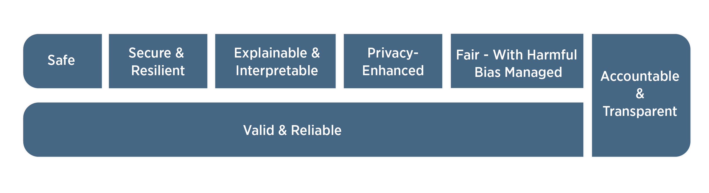
AI Trustworthiness
For AI systems to be trustworthy, they often need to be responsive to a multiplicity of criteria that are of value to interested parties.
Trustworthiness characteristics are inextricably tied to social and organizational behavior, the datasets used by AI systems, selection of AI models and algorithms and the decisions made by those who build them, and the interactions with the humans who provide insight from and oversight of such systems.
October 2025 |

Slide 23
Valid & Reliable AI
Validation is the “confirmation, through the provision of objective evidence, that the requirements for a specific intended use or application have been fulfilled”
Reliability is defined as the “ability of an item to perform as required, without failure, for a given time interval, under given conditions”
Accuracy is defined as “closeness of results of observations, computations, or estimates to the true values or the values accepted as being true.”
Robustness or generalizability is defined as the “ability of a system to maintain its level of performance under a variety of circumstances”
October 2025 |

Slide 24
Safe AI
AI systems should “not under defined conditions, lead to a state in which human life, health, property, or the environment is endangered”. Safe operation of AI systems is improved through:
responsible design, development, and deployment practices;
clear information to deployers on responsible use of the system;
responsible decision-making by deployers and end users; and
explanations and documentation of risks based on empirical evidence of incidents.
October 2025 |

Slide 25
Secure & Resilient
AI systems, as well as the ecosystems in which they are deployed, may be said to be resilient if they can withstand unexpected adverse events or unexpected changes in their environment or use – or if they can maintain their functions and structure in the face of internal and external change and degrade safely and gracefully when this is necessary.
October 2025 |

Slide 26
Accountable & Transparent
Transparency reflects the extent to which information about an AI system and its outputs is available to individuals interacting with such a system – regardless of whether they are even aware that they are doing so.
October 2025 |

Slide 27
Explainable & Interpretable
Transparency, explainability, and interpretability are distinct characteristics that support each other.
Transparency can answer the question of “what happened” in the system. Explainability can answer the question of “how” a decision was made in the system. Interpretability can answer the question of “why” a decision was made by the system and its meaning or context to the user.
October 2025 |

Slide 28
Privacy-Enhanced
Privacy values such as anonymity, confidentiality, and control generally should guide choices for AI system design, development, and deployment.
Privacy-enhancing technologies (“PETs”) for AI, as well as data minimizing methods such as de-identification and aggregation for certain model outputs, can support design for privacy-enhanced AI systems.
October 2025 |

Slide 29
Fair
Fairness in AI includes concerns for equality and equity by addressing issues such as harmful bias and discrimination. Standards of fairness can be complex and difficult to define because perceptions of fairness differ among cultures and may shift depending on application.
October 2025 |

